Slide 1
Netzwerk Academy
Machine Learning
By
Navya Raj

Slide 2
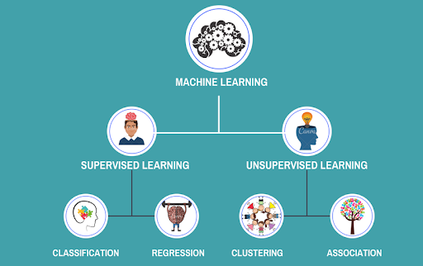

Slide 3
Supervised Learning:
It works under supervision, so Basically In this model is able to predict with the help of labeled dataset.
Classification:
When the o/p variable is categorical i.e with 2 or more class or say multiclass.
Ex: yes/no, male/female , 0/1
Regression:
It is basically a relationship b/w two or more variables where a change in one variable associated with a change in other variable.

Slide 4
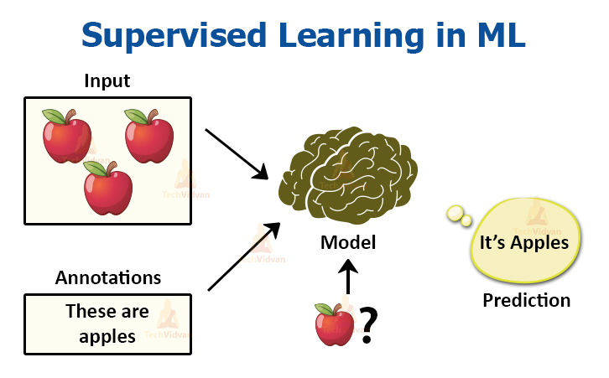

Slide 5
Unsupervised Learning:
In this type of learning there is no supervision and the algorithm is trained using data that is unlabeled.
Clustering:
METHOD OF Dividing data into cluster which are similar b/w them and are dissimilar to the objects belonging to another cluster.
Association:
Discovering the probability of the co-occurrence of items in a collection.

Slide 6
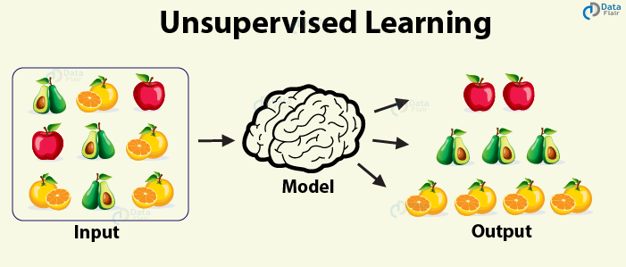

Slide 7
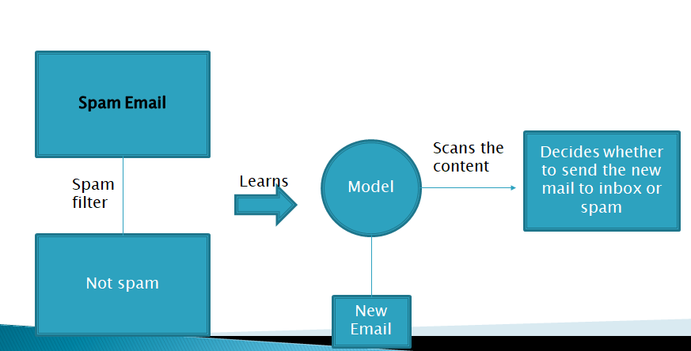
Example:

Slide 8
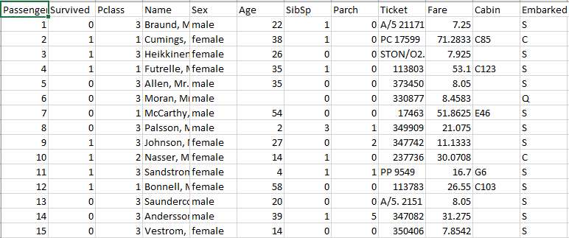
Train data

Slide 9
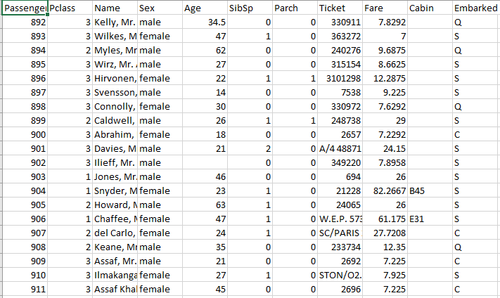
Test data

